Slide 1
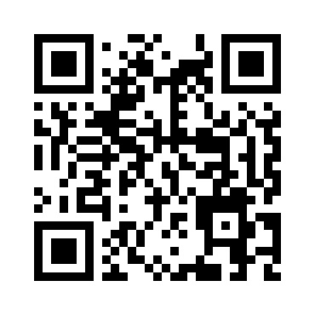
HDMapping v0.94
MapsHD/HDMapping
januszbedkowski@gmail.com

Slide 2
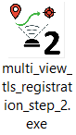
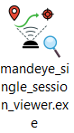
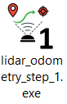
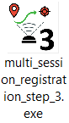
Workflow diagram
Ground truth session
QC 1
Data collection
mandeye_raw_data_viewer
QC 2
Data publication (LAZ)

Slide 3
Assumptions:
1. Project is composed of multiple sessions
2. Only one session in the project can be „ground truth”
3. multi_session_registration_step_3.exe performs pose graph slam
4. It is possible to add Edge for single session (similar to multi_view_tls_registration_step_2.exe)
5. It is possible to add Edge for two different sessions
6. „Ground truth” can not be changed (gizmo is disabled), only multi_view_tls_registration_step_2.exe can change „Ground truth” flag

Slide 4
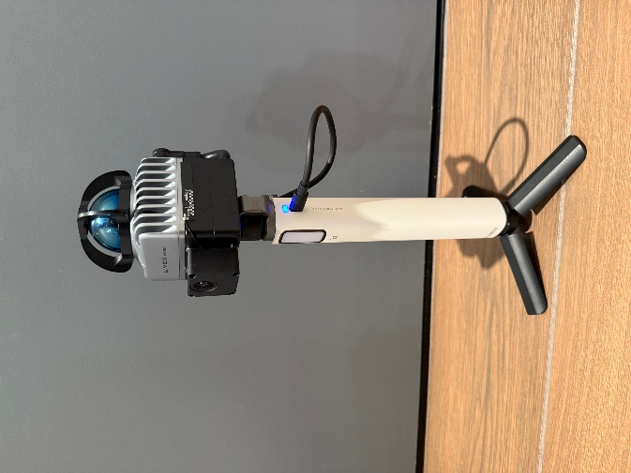
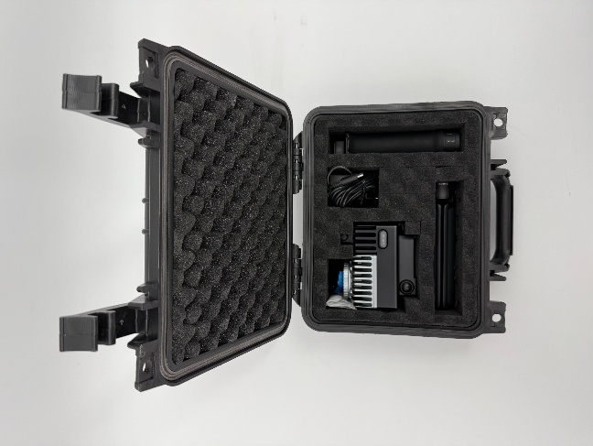
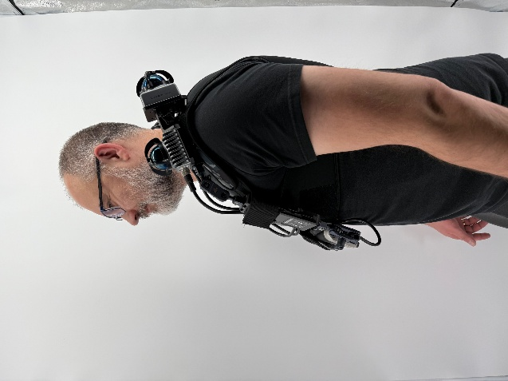
Collect data with MANDEYE

Slide 5
Inspect data with
mandeye_raw_data_viewer
QC 1

Slide 6
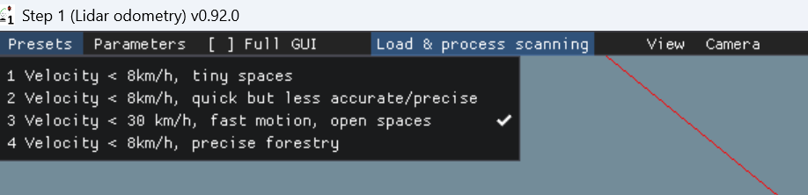
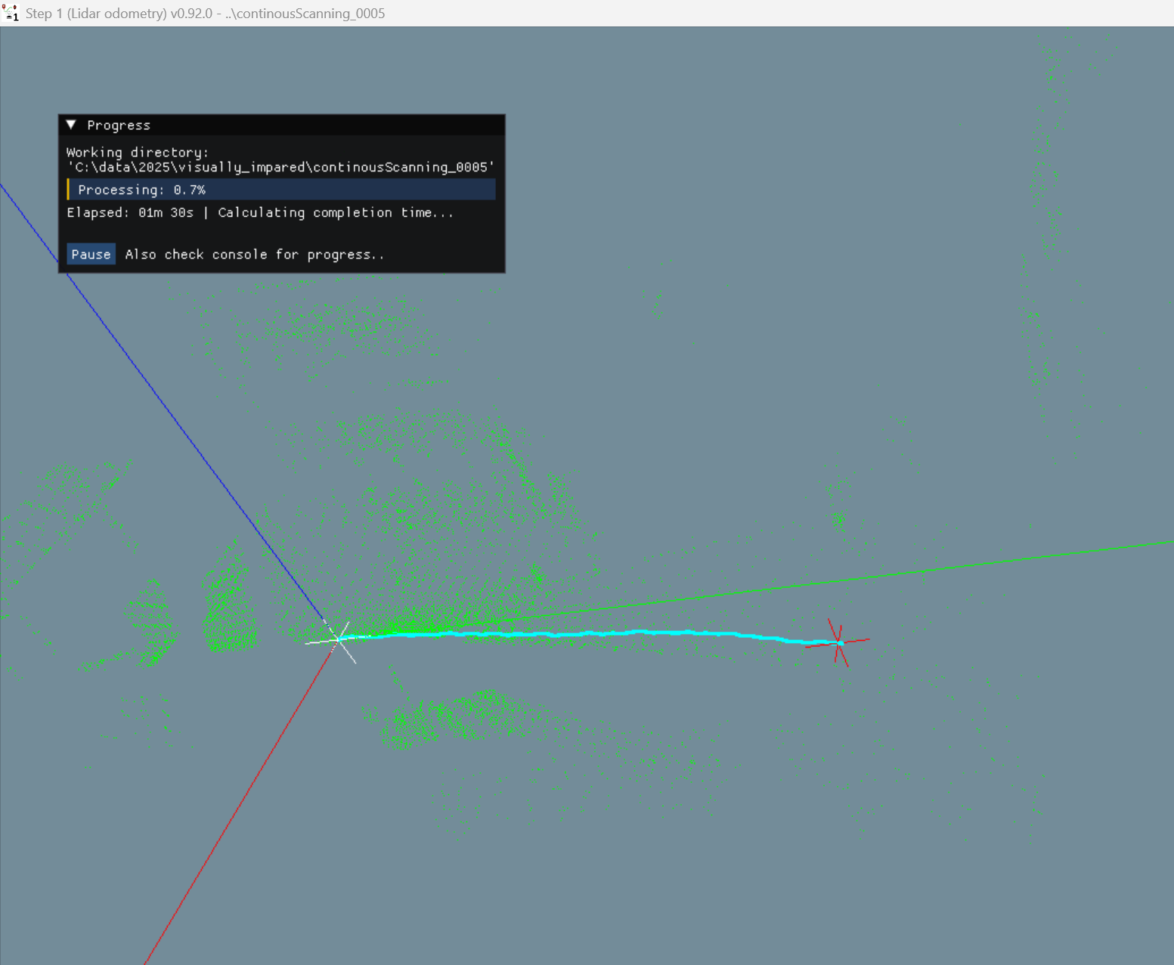
LiDAR inertial odometry
Software: lidar_odometry_step_1.exe
Choose one of Presets
- Velocity < 8km/h is dedicated for caves, tiny spaces, inside tiny rooms
- Velocity < 8km/h, quick but less accurate/precise is using less iterations in optimization
- Velocity < 30km/h, fast motion, open spaces removes points in 3m radious so it can not be used in tiny spaces
- Velocity < 8km/h, precise forestry is for making map in the forest
2. Load & proces scanning
- seclect folder containing MANDEYE data
- observe trajectory

Slide 7
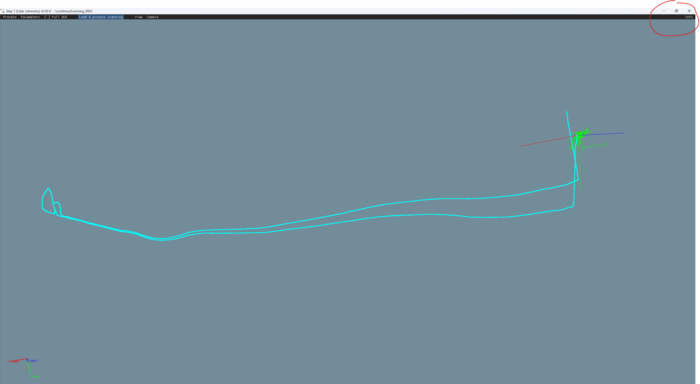
LiDAR inertial odometry
Software: lidar_odometry_step_1.exe
Finally, program will inform where data is saved.

Slide 8
Inspect data with
QC 2

Slide 9
IMU versus LiDAR inertial odometry error quality check

Slide 10
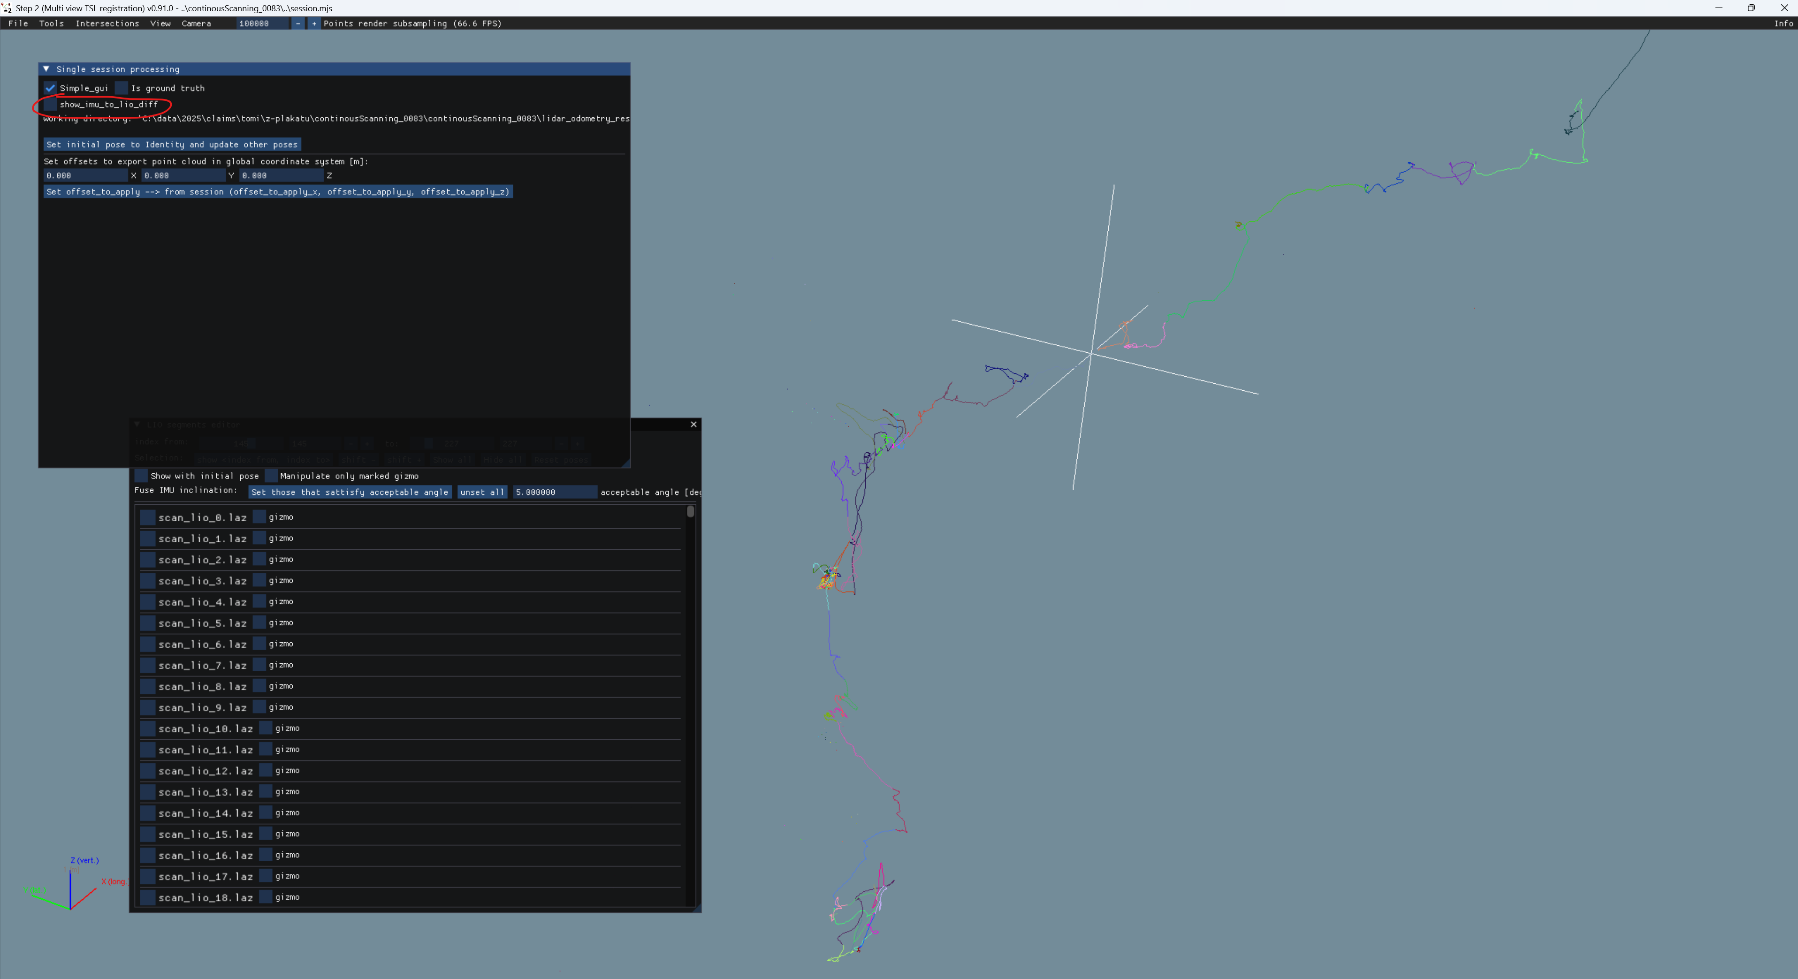
After session load in step2, use show_imu_to_lio_diff to check for large differences between LiDAR and IMU estimations

Slide 11


Slide 12
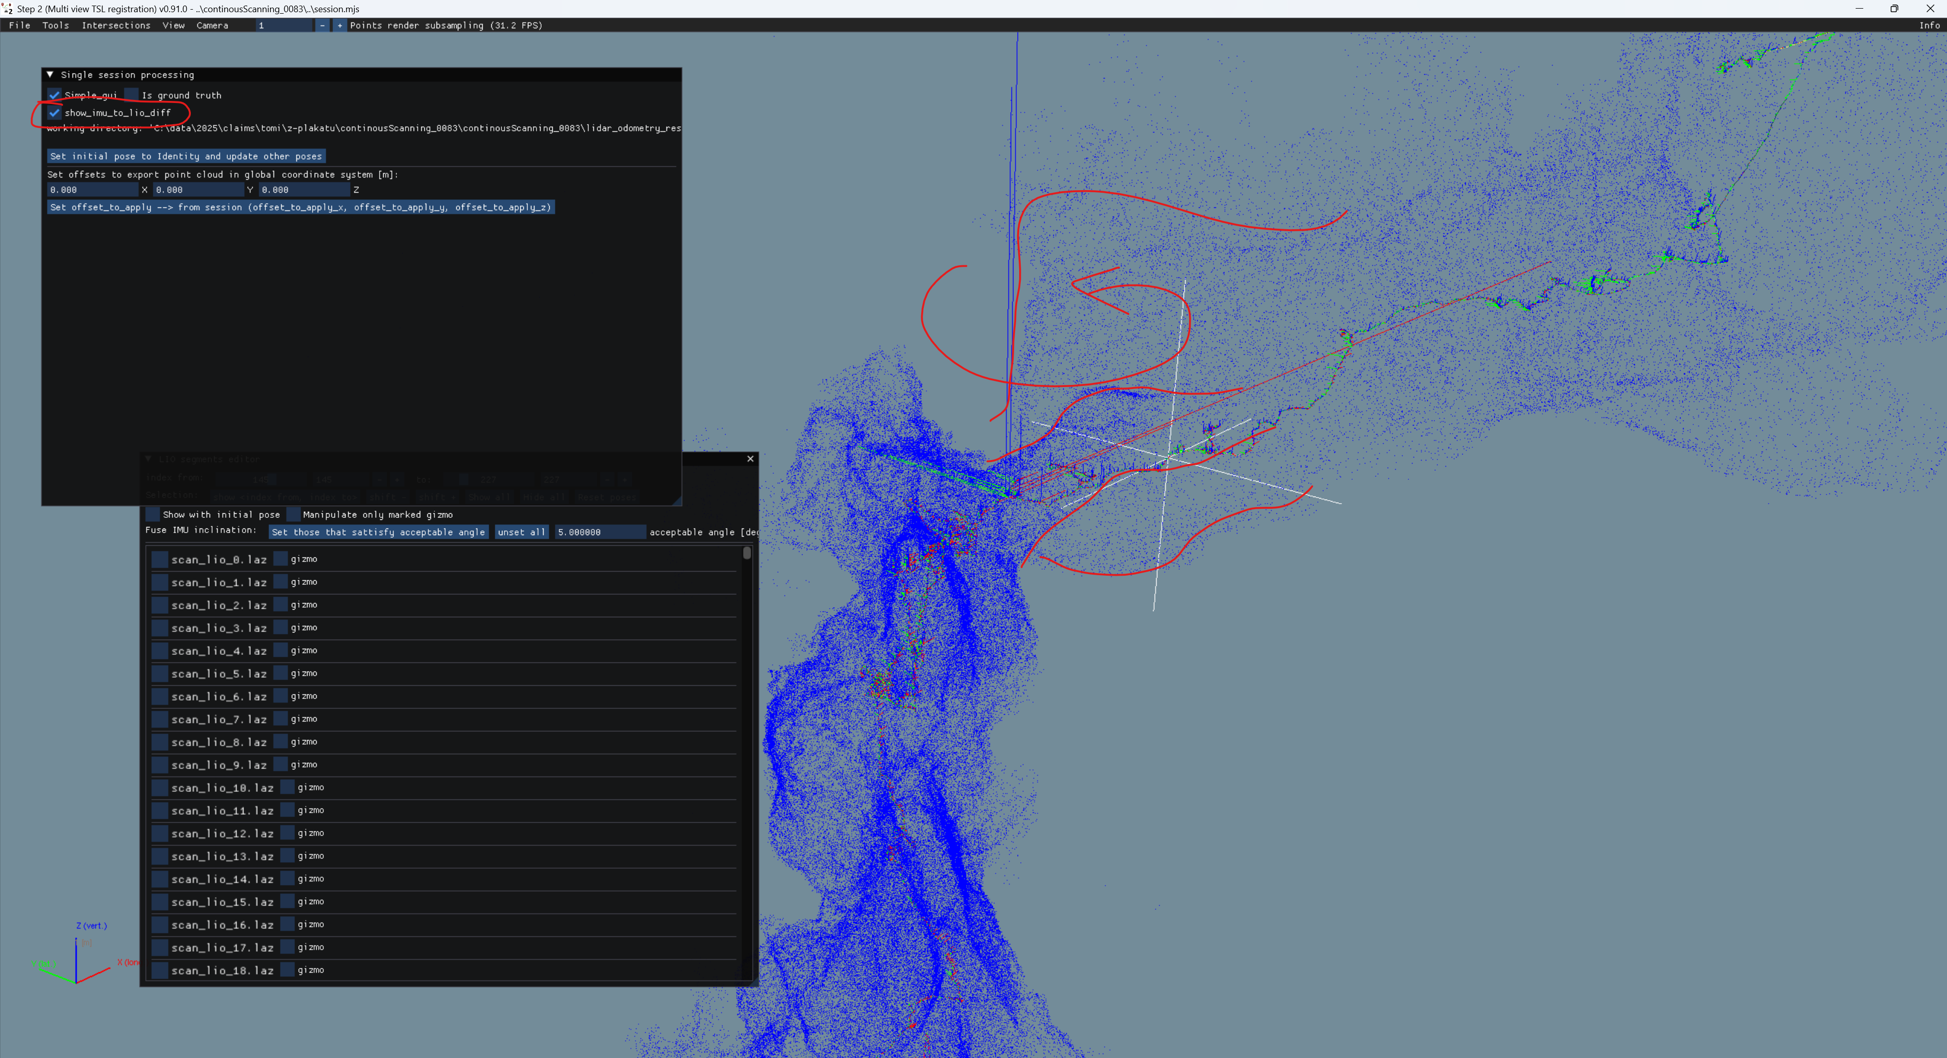
WHAT IS SHOWN HERE???

Slide 13
Split session ToDo
Once the error in session is identified it is advised to split session with omitting corrupted data

Slide 14
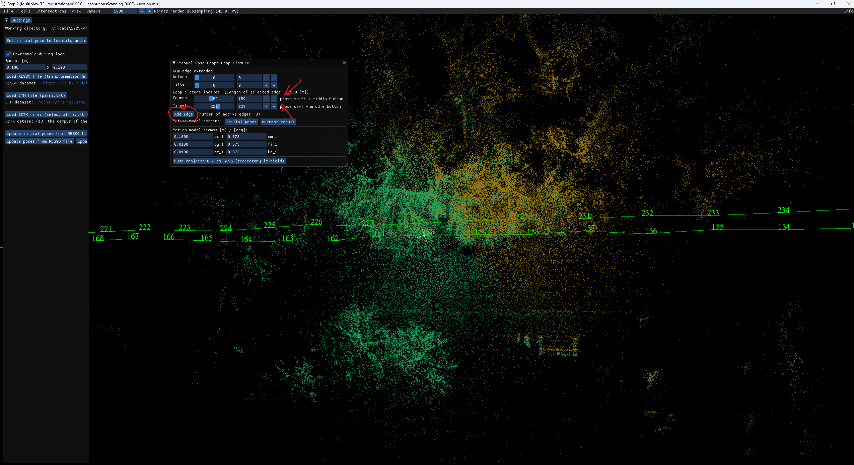

Slide 15
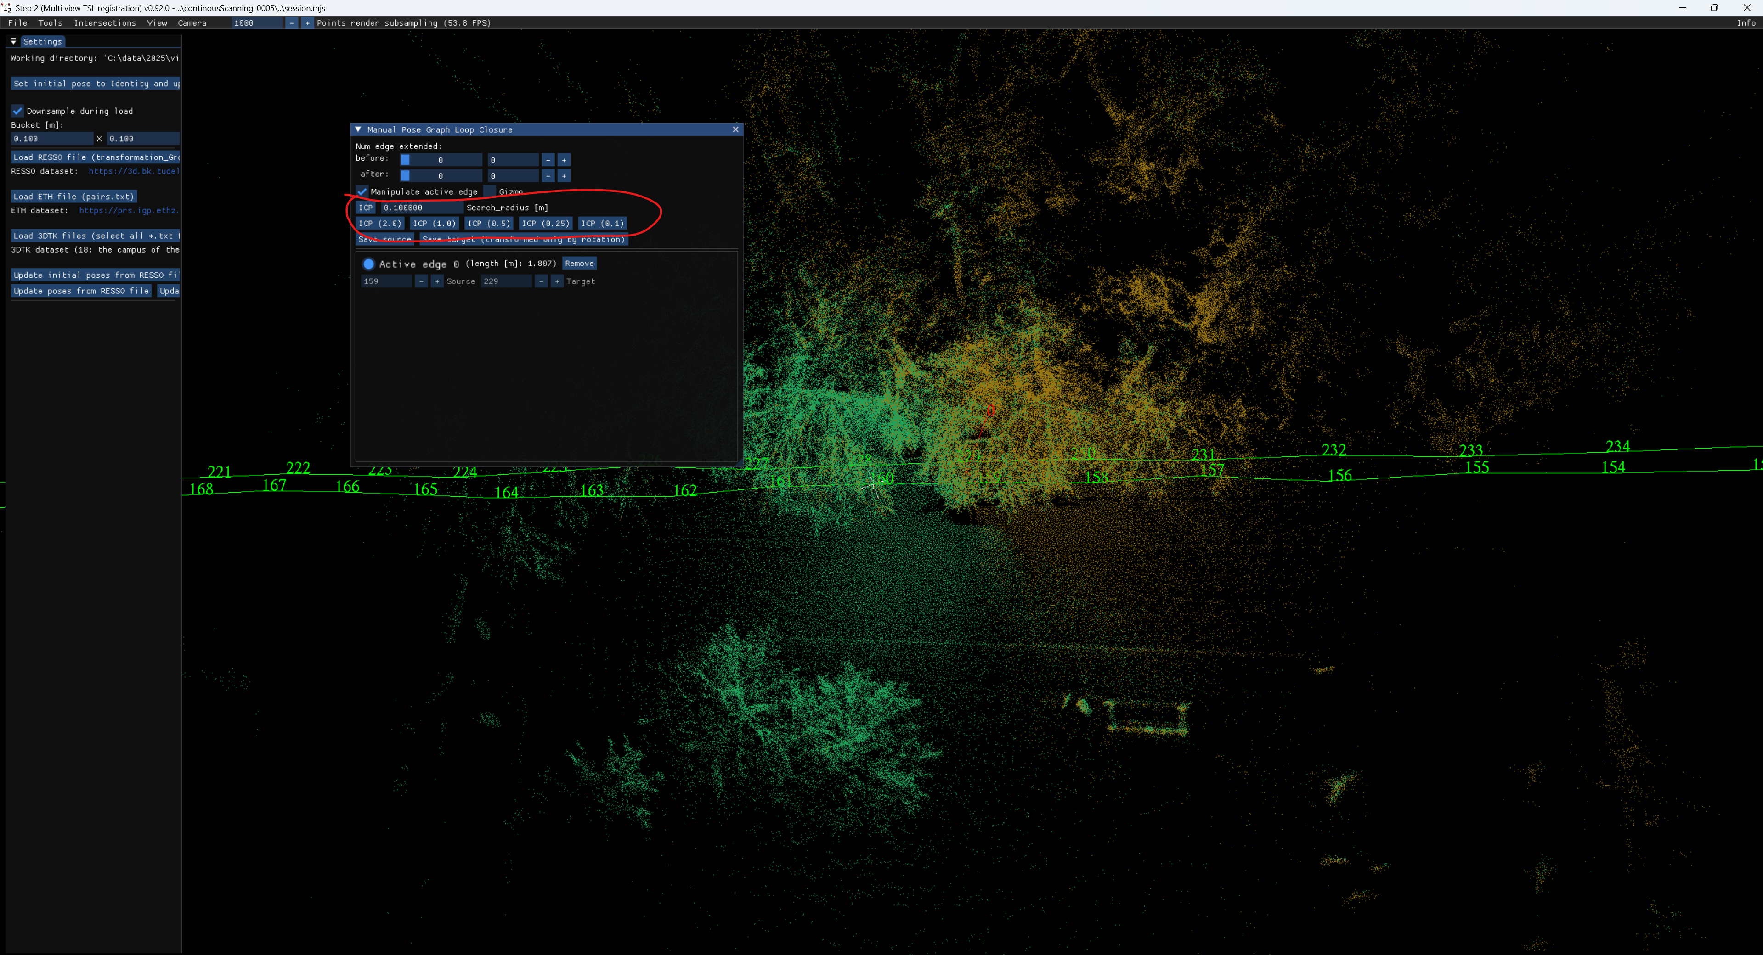

Slide 16
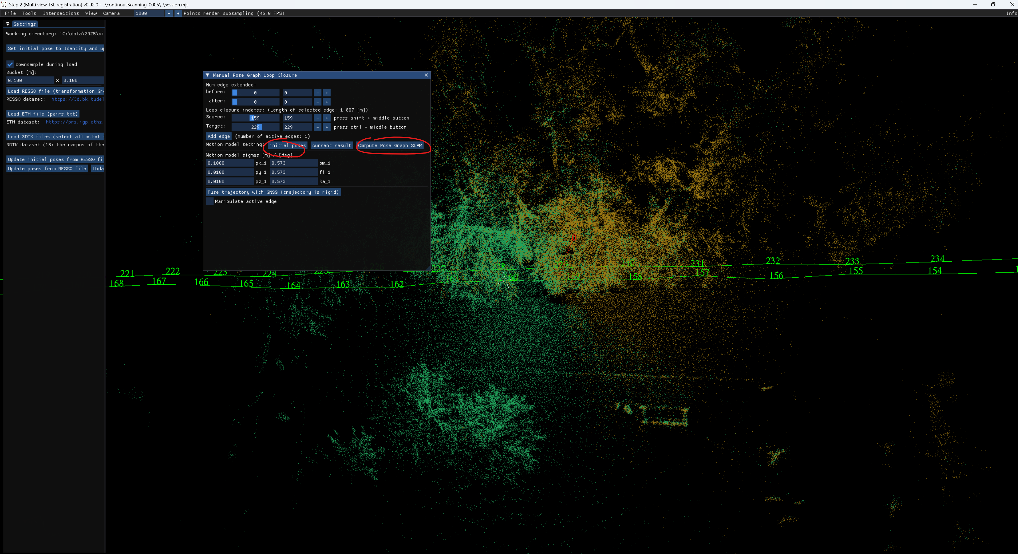

Slide 17
Georeferencing to ground truth point cloud

Slide 18
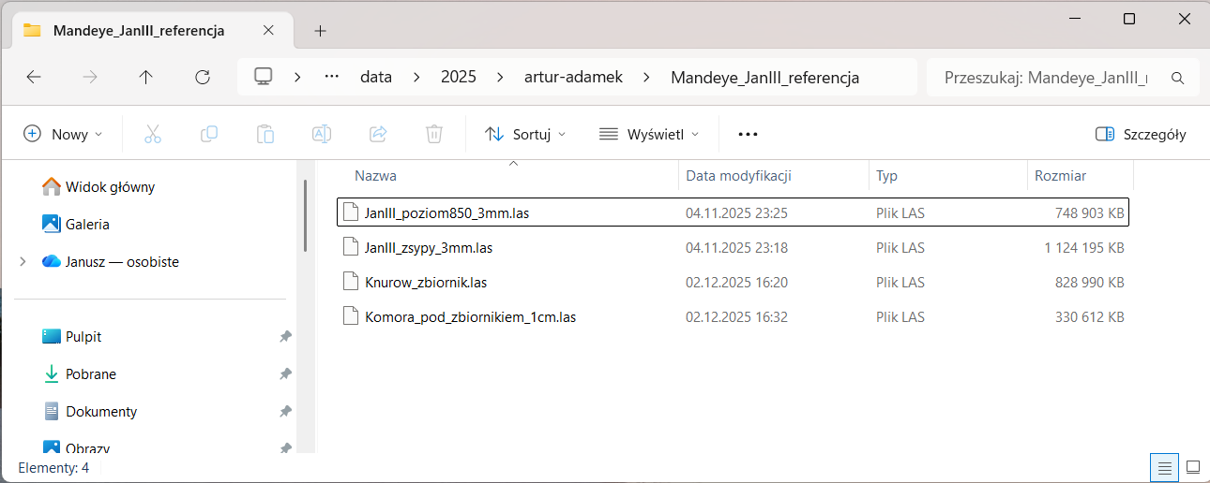
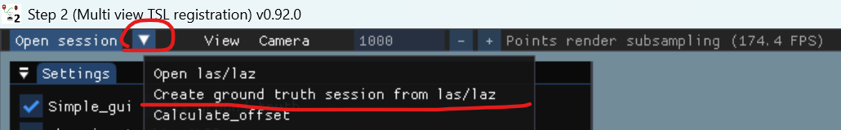
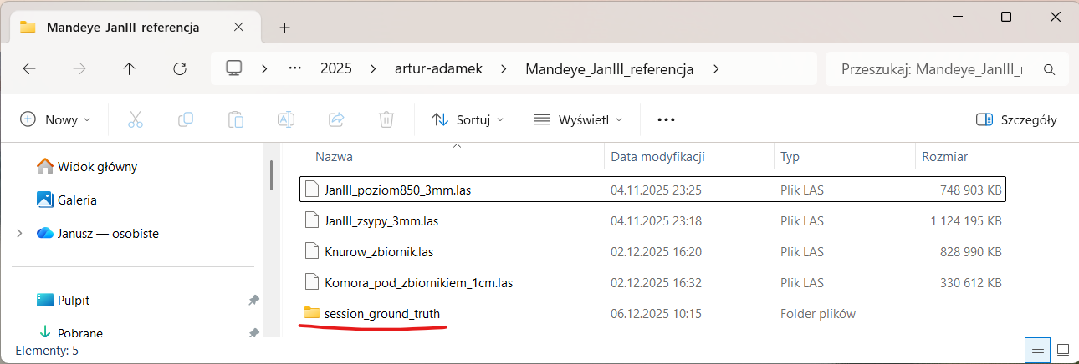
Creating ground truth session from point clouds
1. Using multi_view_tls_registration_step_2.exe
collect ground truth point clouds (laz/las) in one folder
2. Click in menu Create ground truth session from las/laz
3. New session_ground_truth will appear -> use it in step3

Slide 19
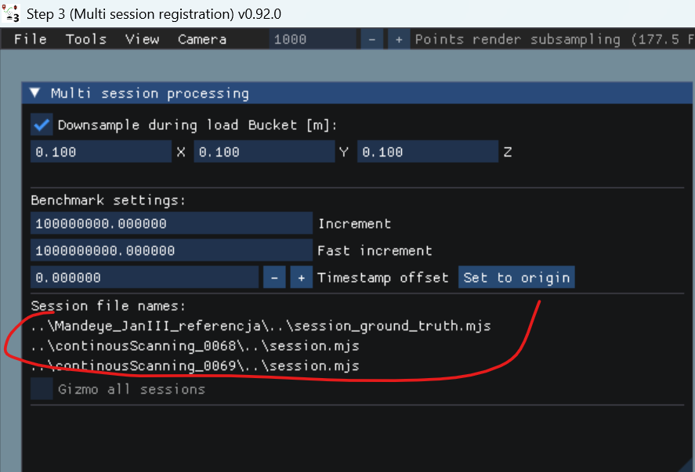
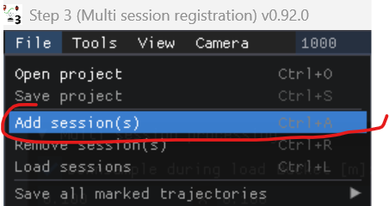
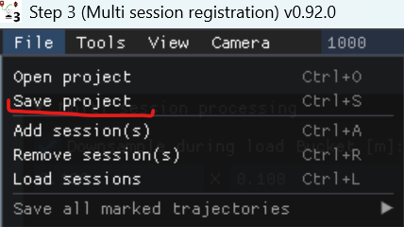
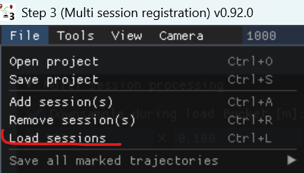
Creating multi session project
1. using multi_session_registration_step_3.exe add session to project
2. Save project
3. Load sessions

Slide 20
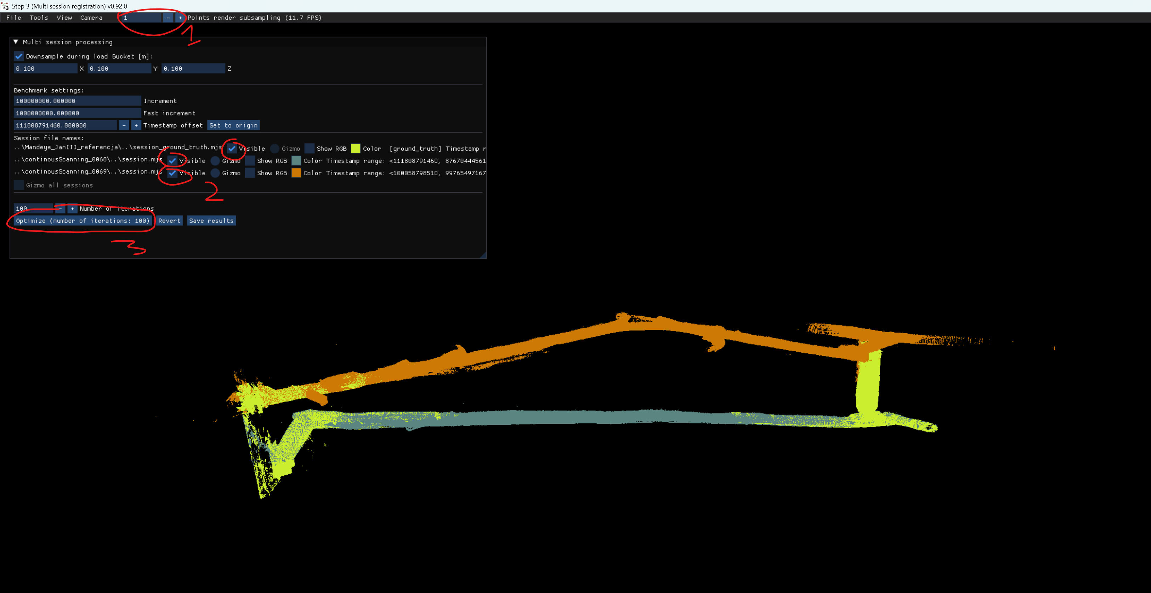
Multi session project – important GUIs
1. downsample point cloud
2. sect sessions to work with (select 1 to work like in step2,
select 2 to add Edge between two sessions)
3. select 3 to apply pose graph slam

Slide 21
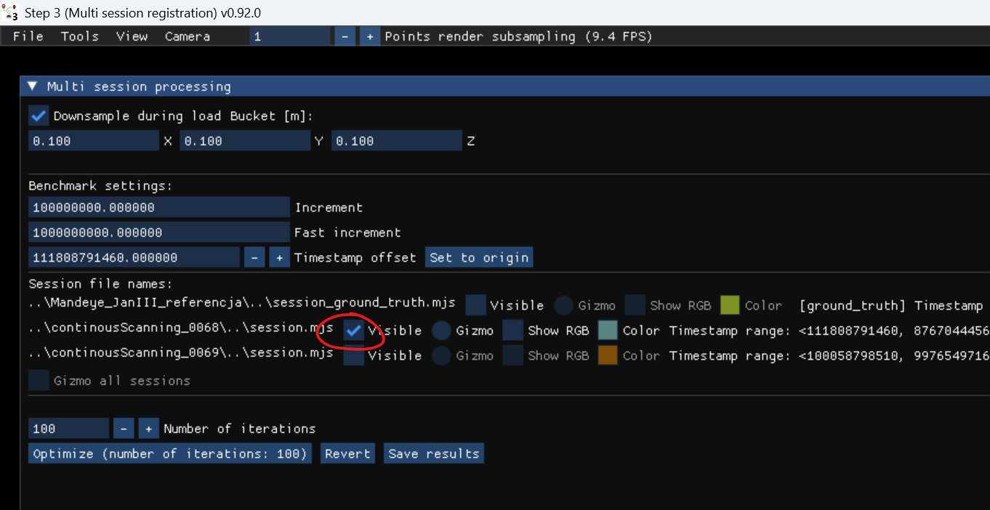
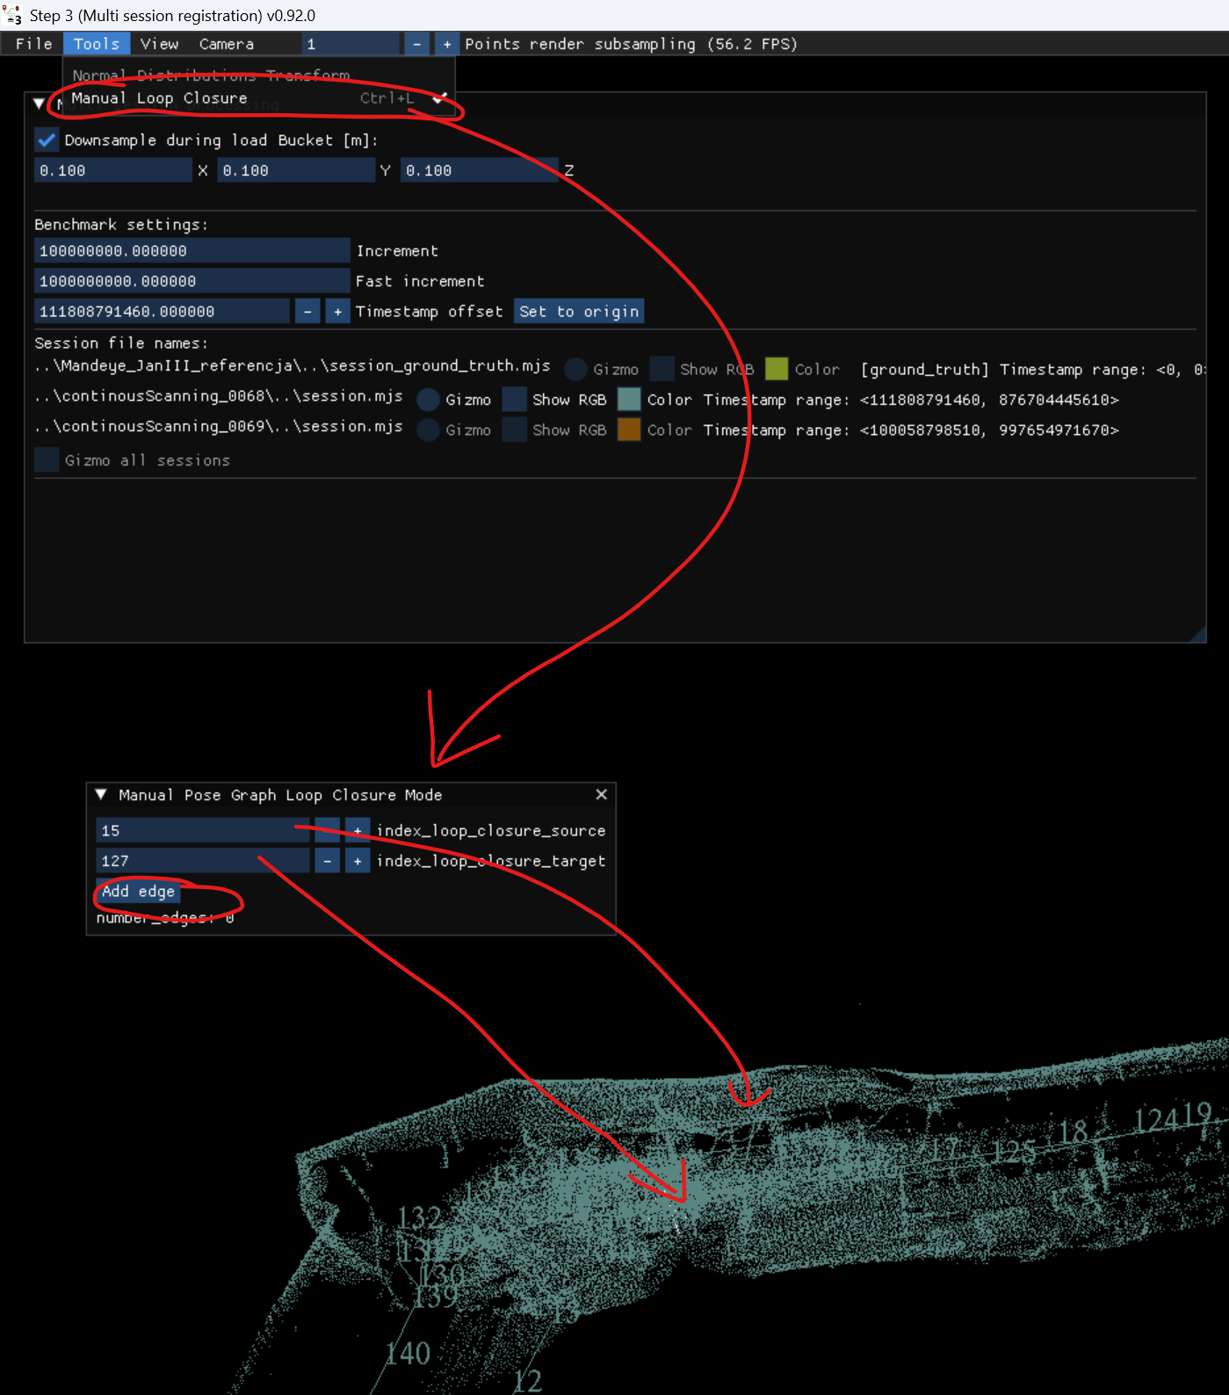
Multi session project – create edge for single point cloud
1. Select 1 session
2. Select Manual Loop Closure
3. Choose 2 nodes
4. Click Add Edge

Slide 22
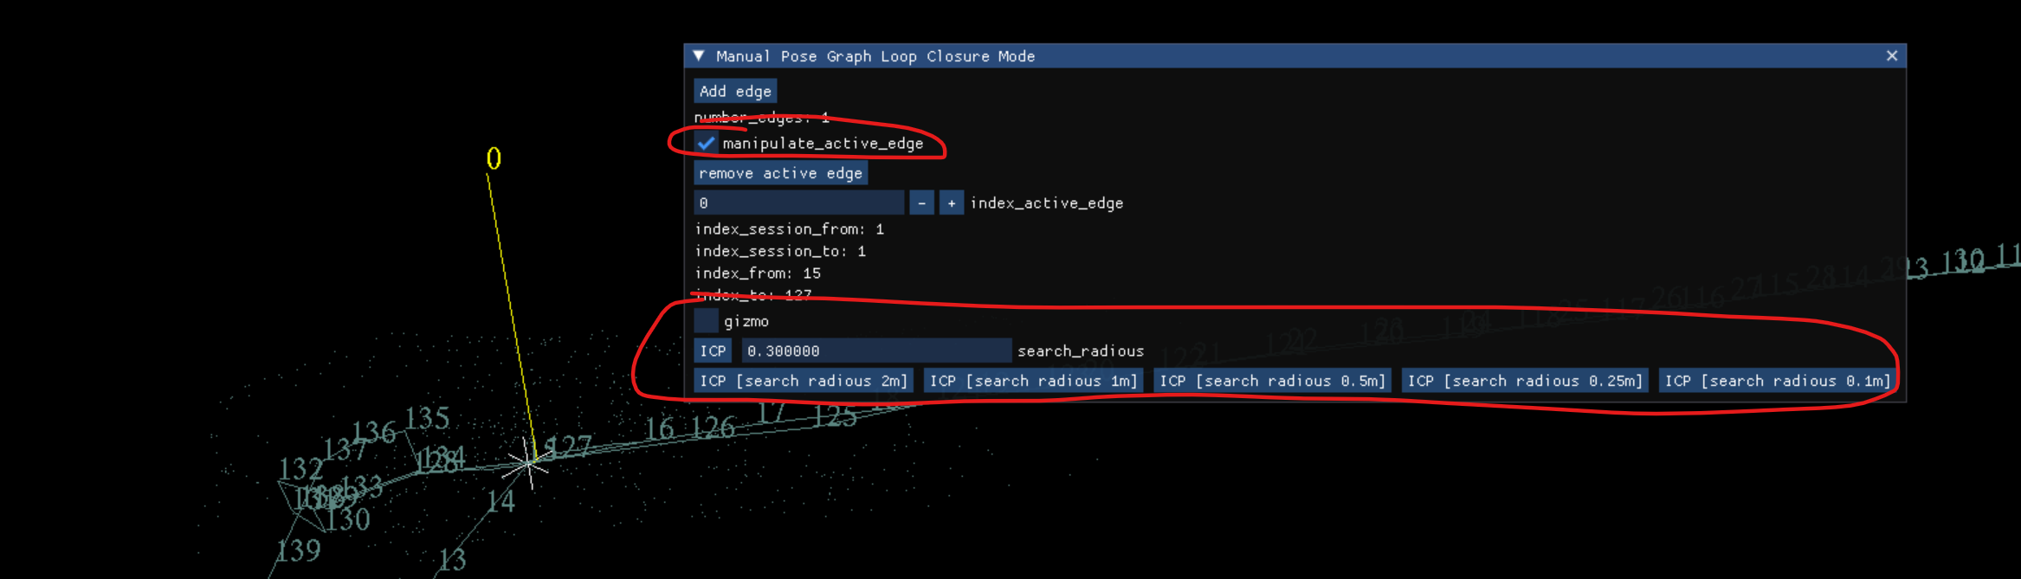
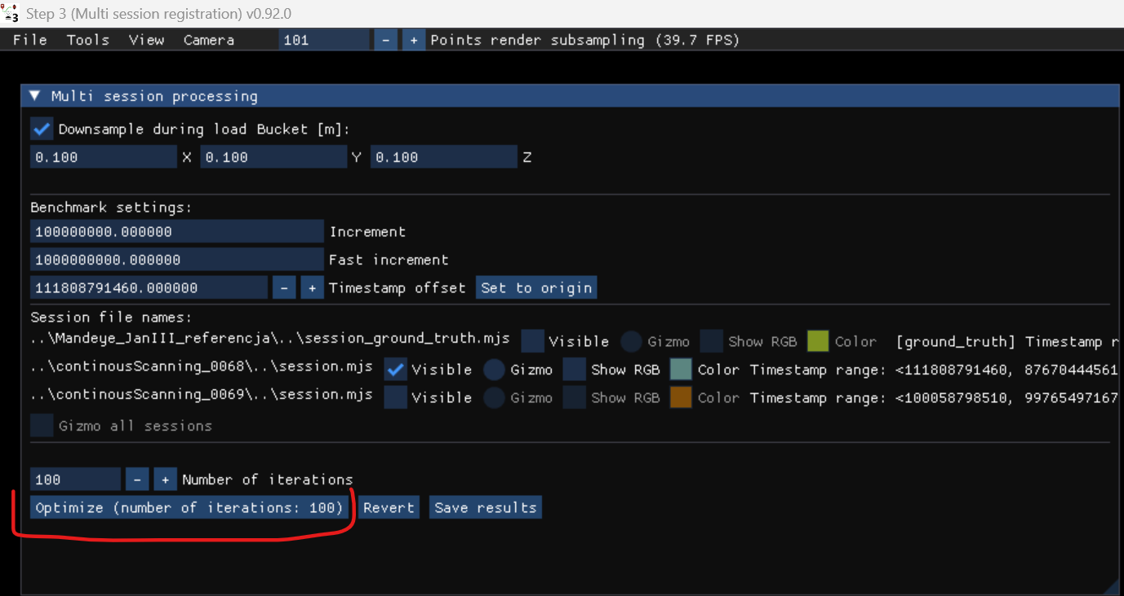
Multi session project – create edge
1. Select manipulate_active_edge
2. Use ICP to align two point clouds
3. Aplly pose graph slam

Slide 23
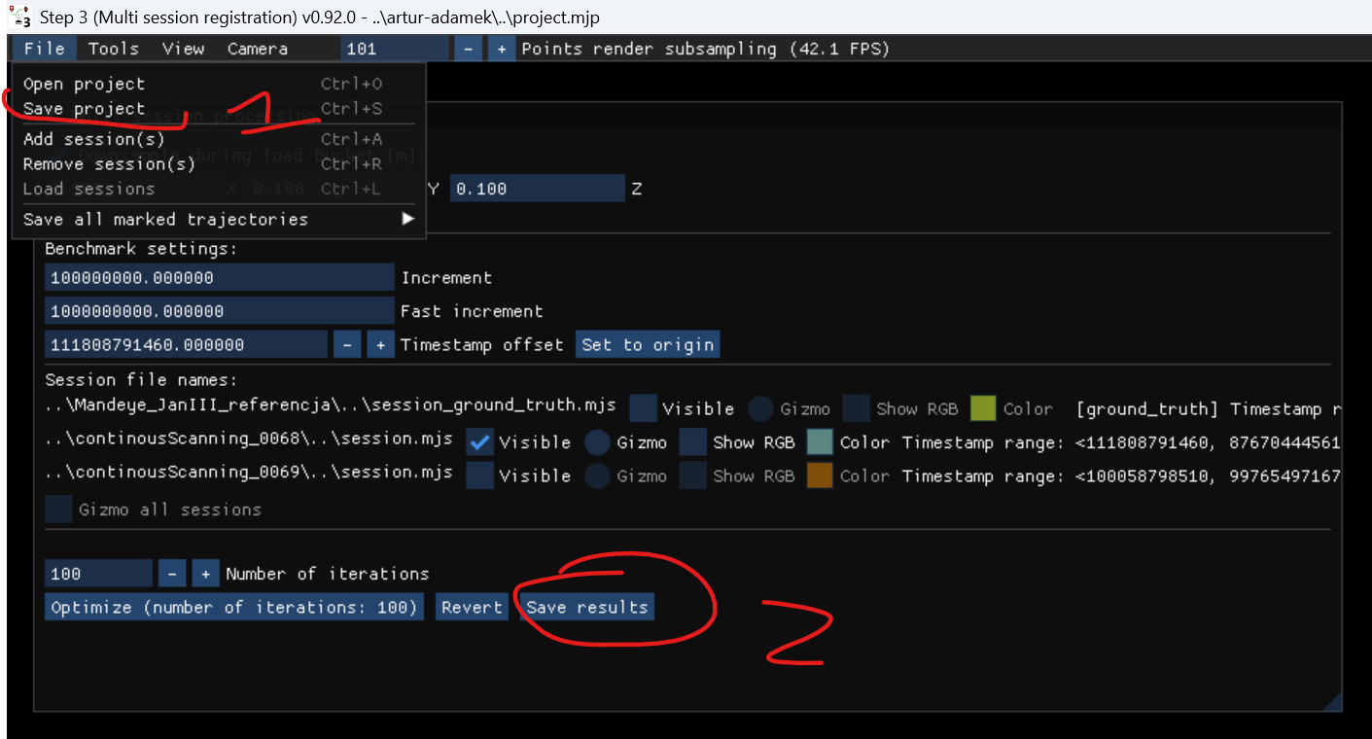
Creating multi session project – save intermediate results
1. Each time you add edge it is advised to save results (two steps)

Slide 24
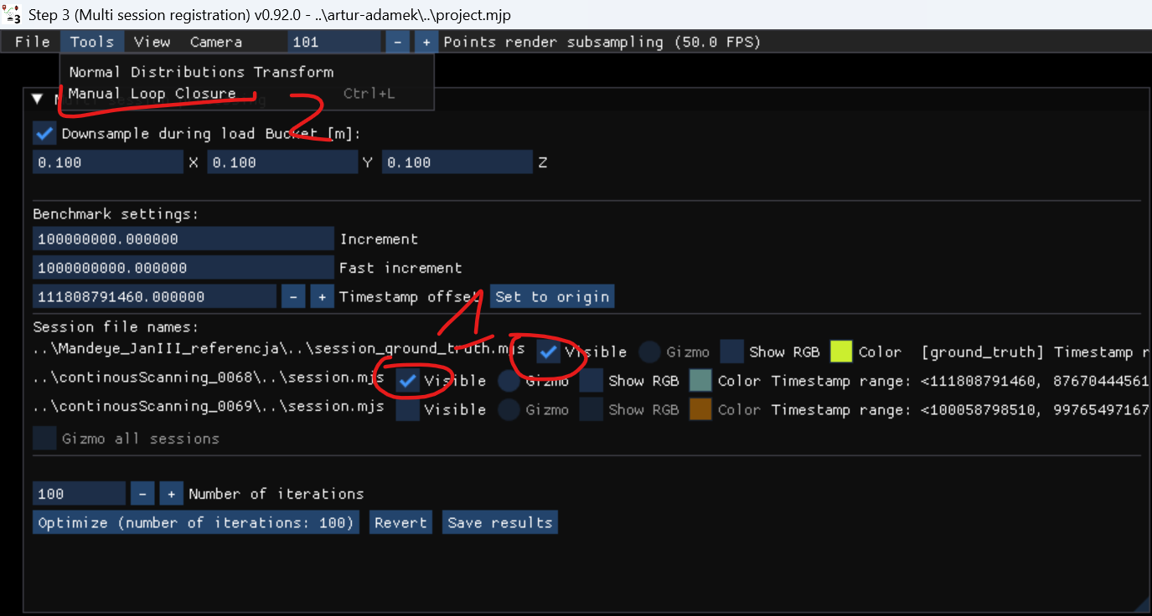
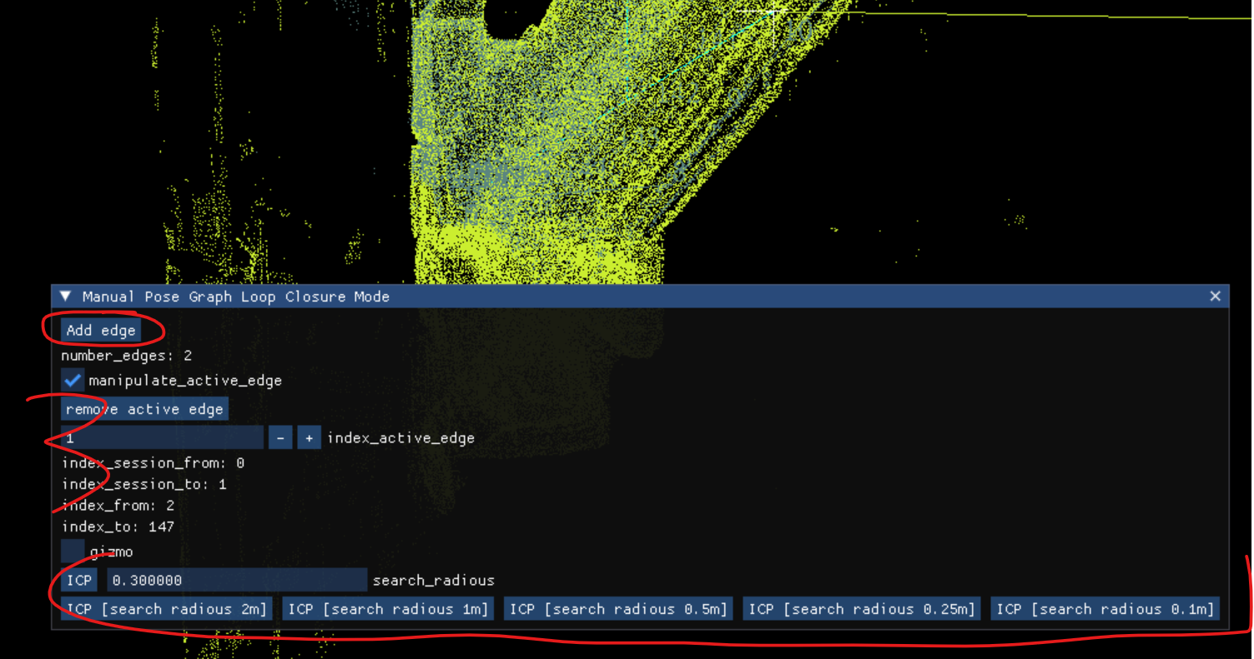
Creating multi session project – create edge for two point clouds
1. Select two point clouds
2. Select Manual Loop Closure
3. Add Edge and use ICP to align two point clouds

Slide 25
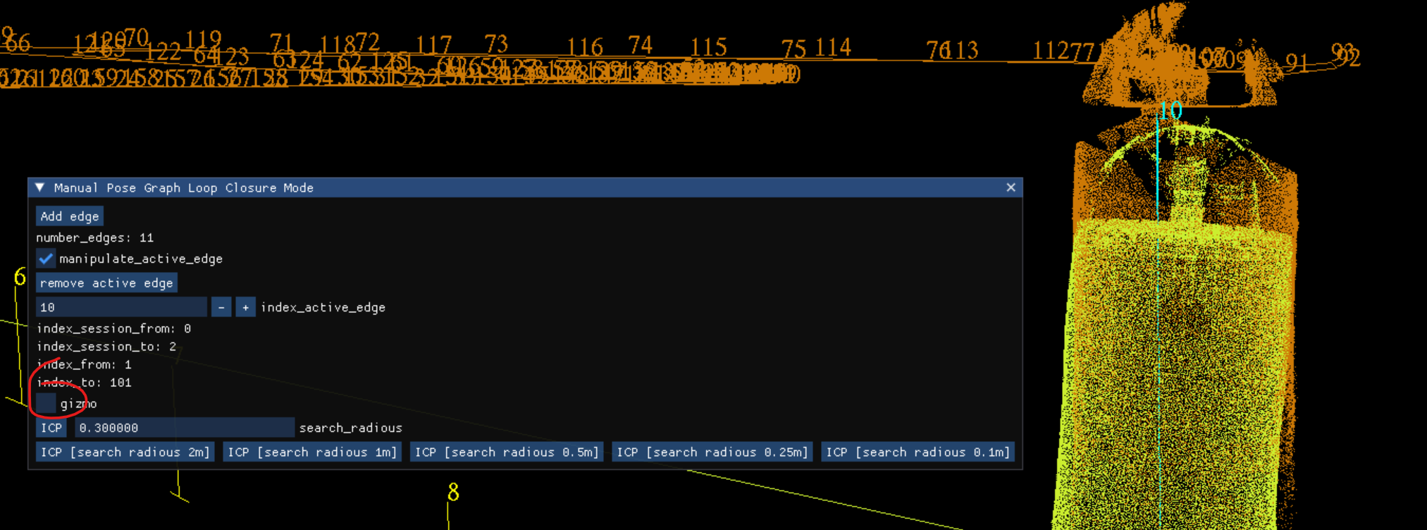
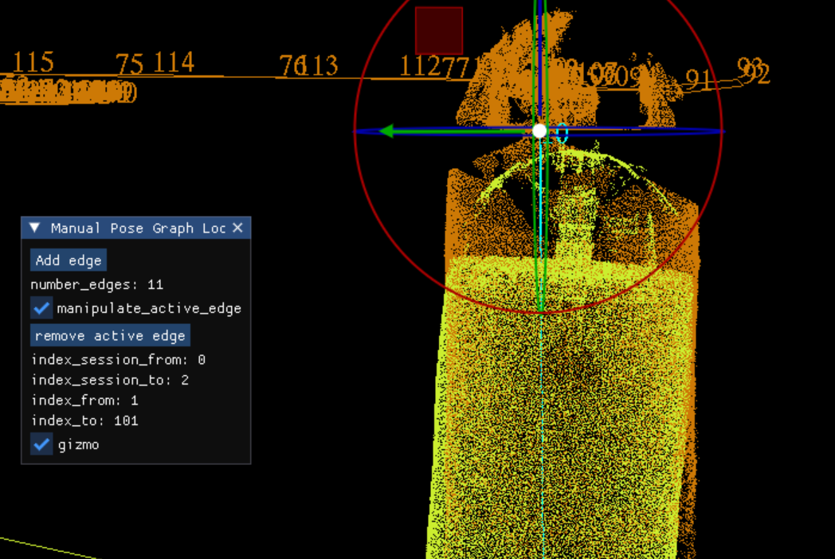
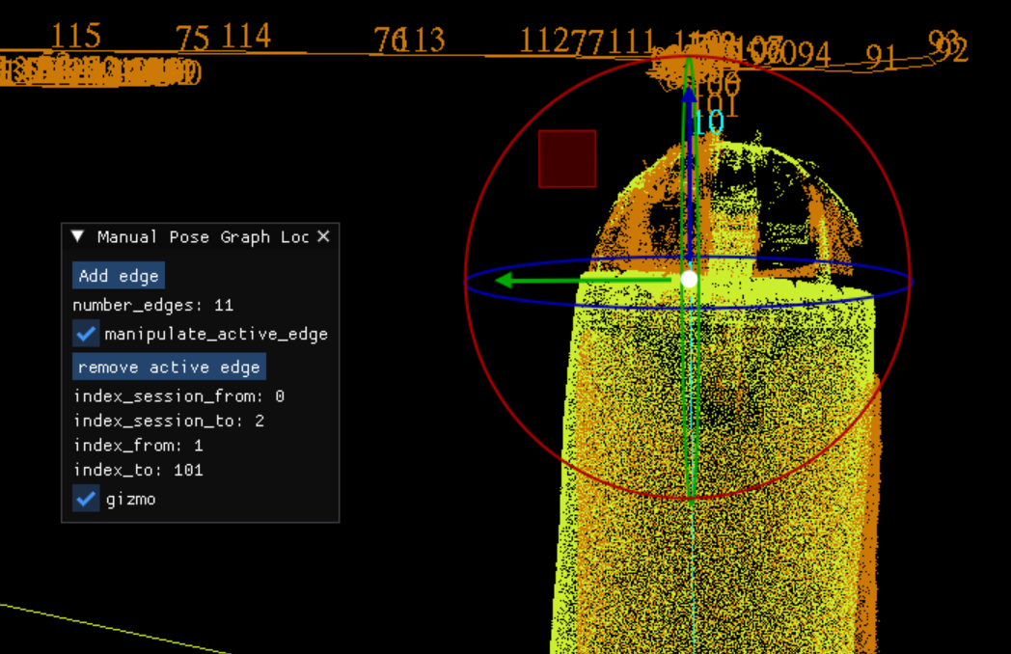
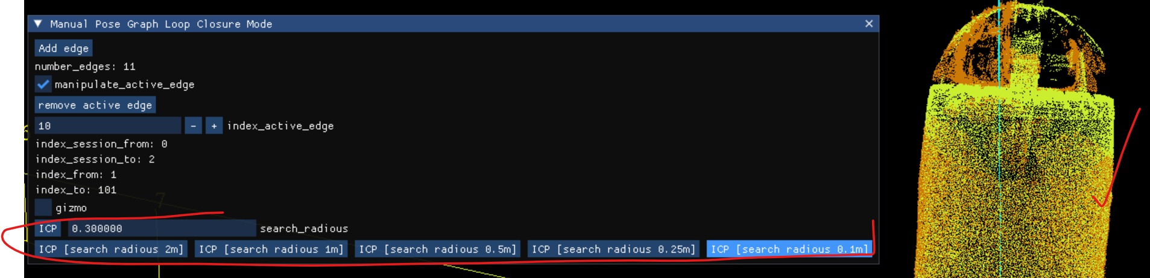
Creating multi session project – manual edge alignment with gizmo
1. Use gizmo to align manually if necessary, finally ICP

Slide 26
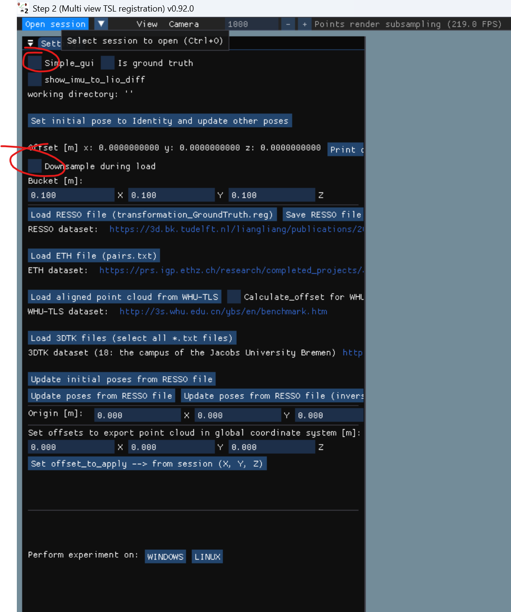
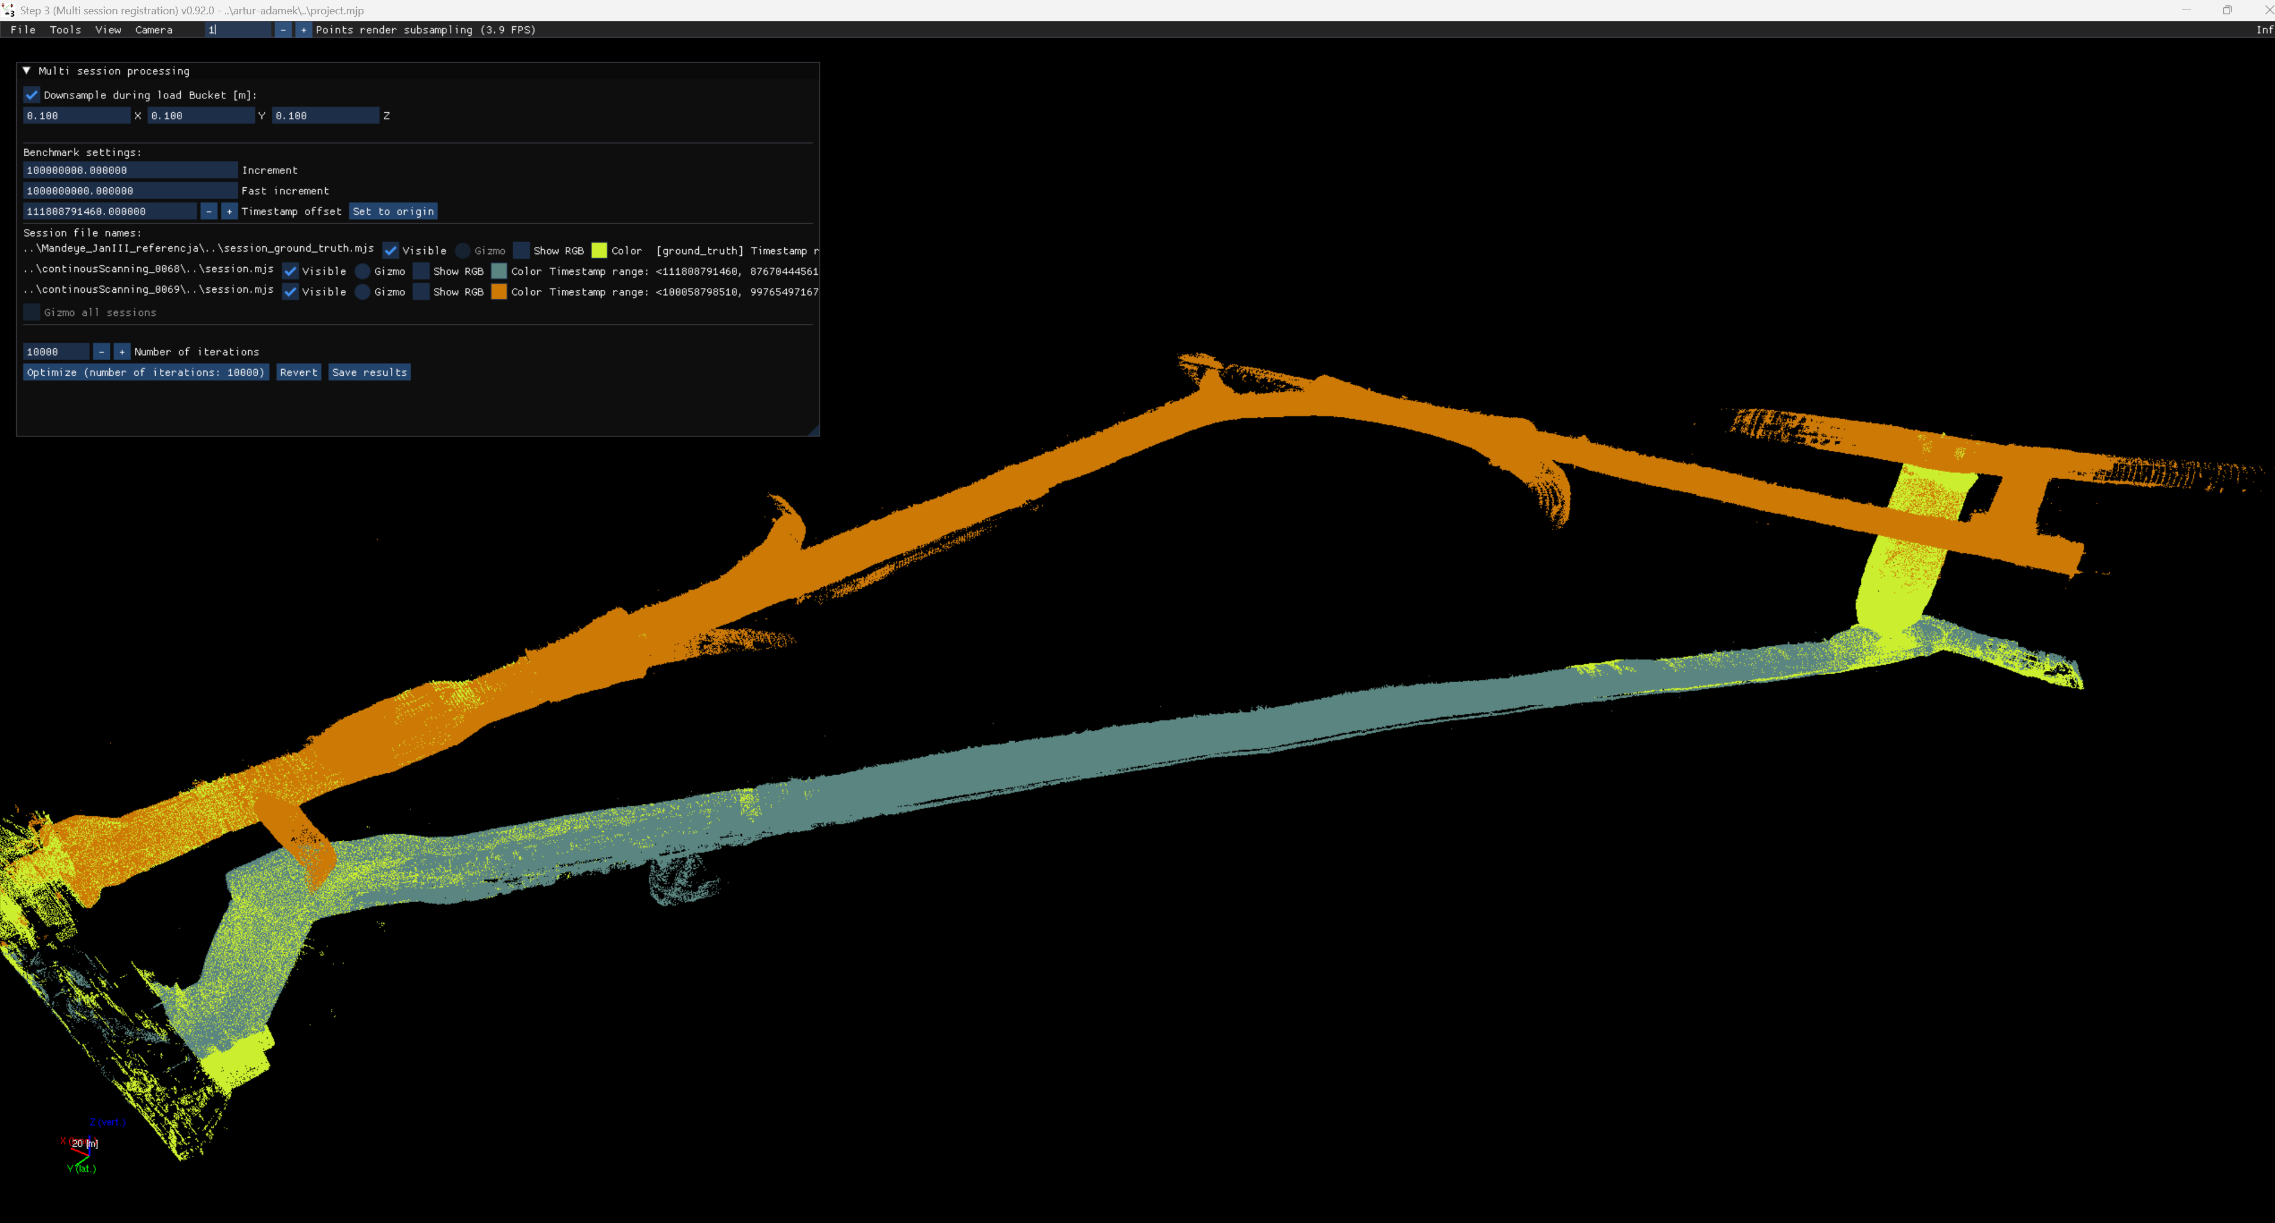
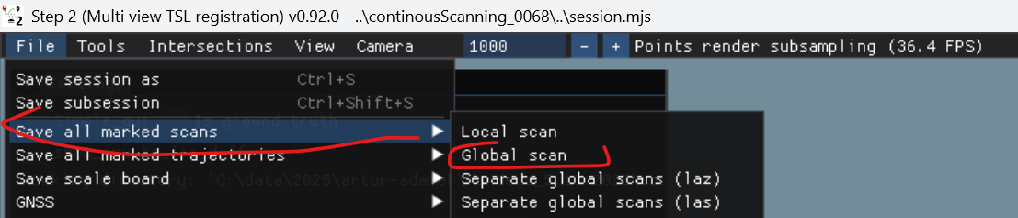
Multi session project - final step
1. Publish data using multi_view_tls_registration_step_2.exe (remember to unmark ‚downsample durig load’)

Slide 27

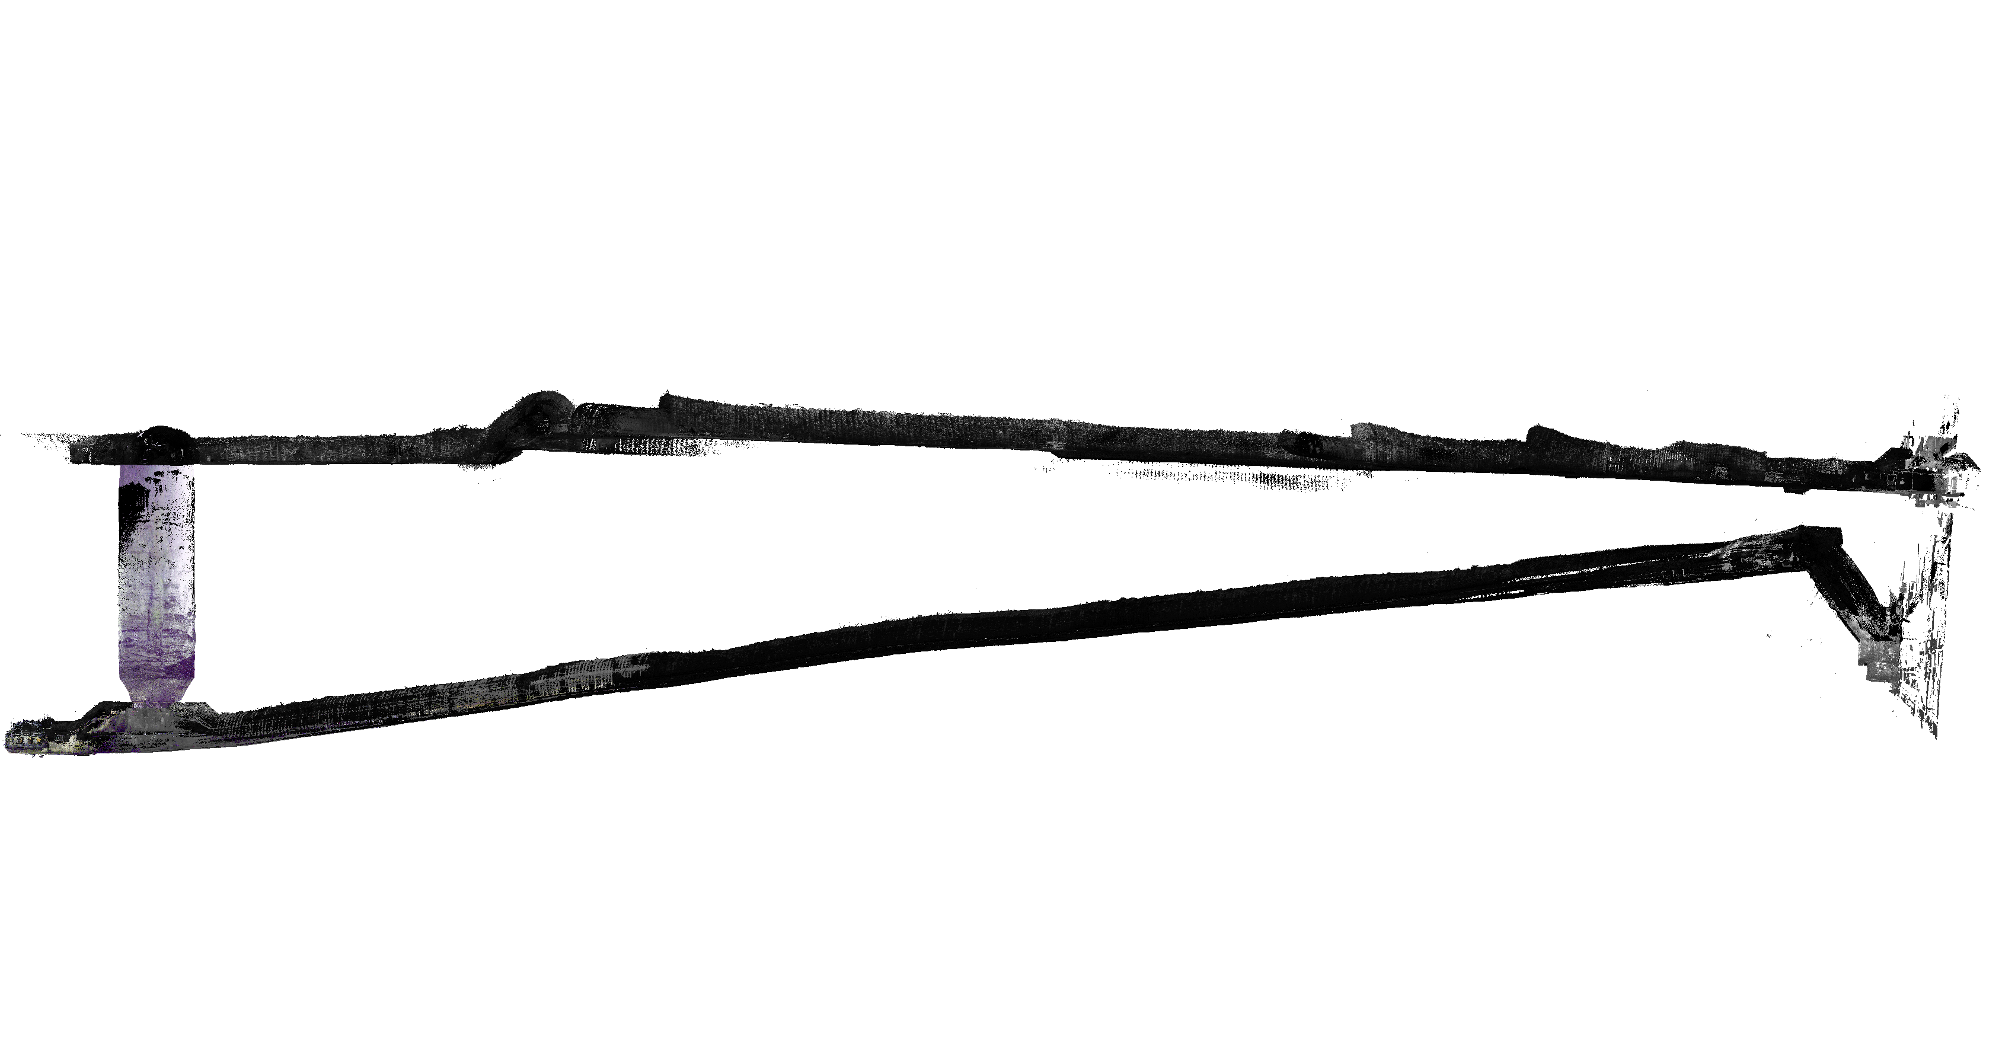
Multi session project - inspect data in CloudCompare

Slide 28
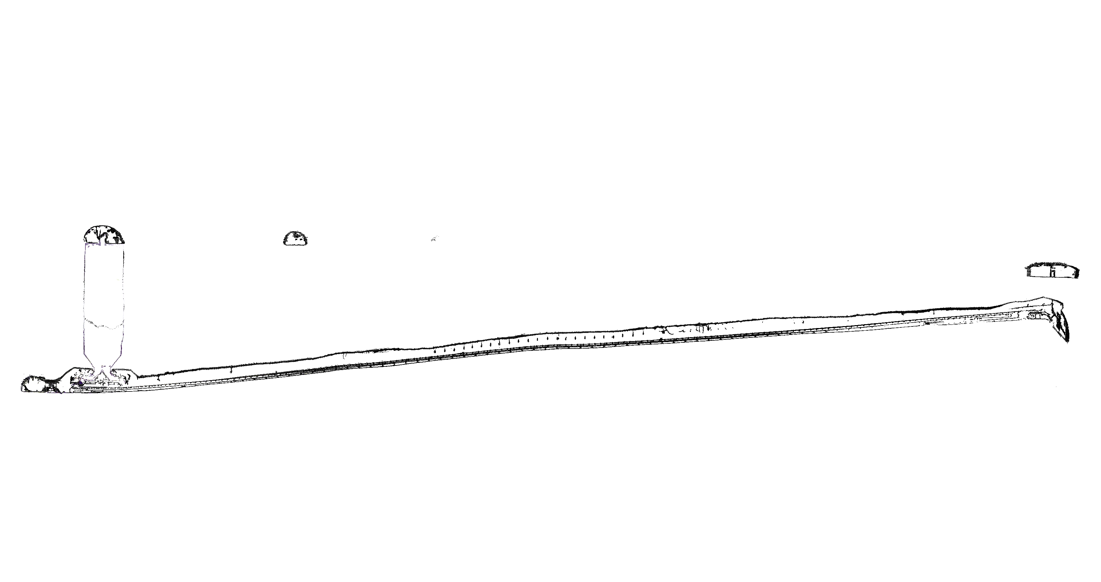
Multi session project - inspect data in CloudCompare

Slide 29
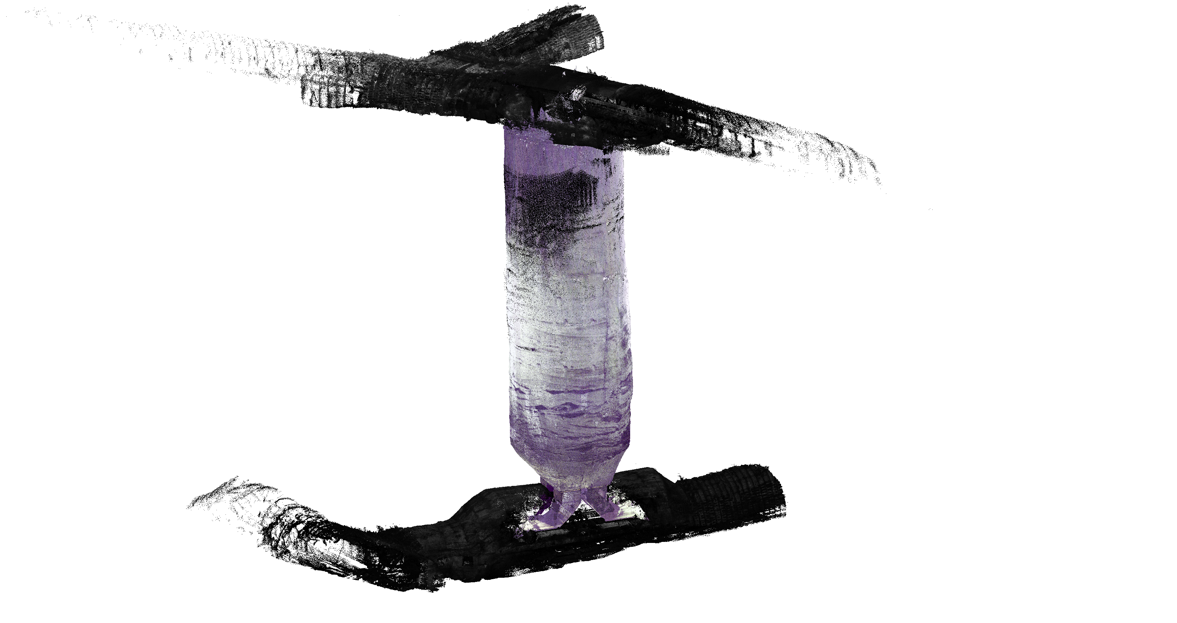
Multi session project - inspect data in CloudCompare

Slide 30
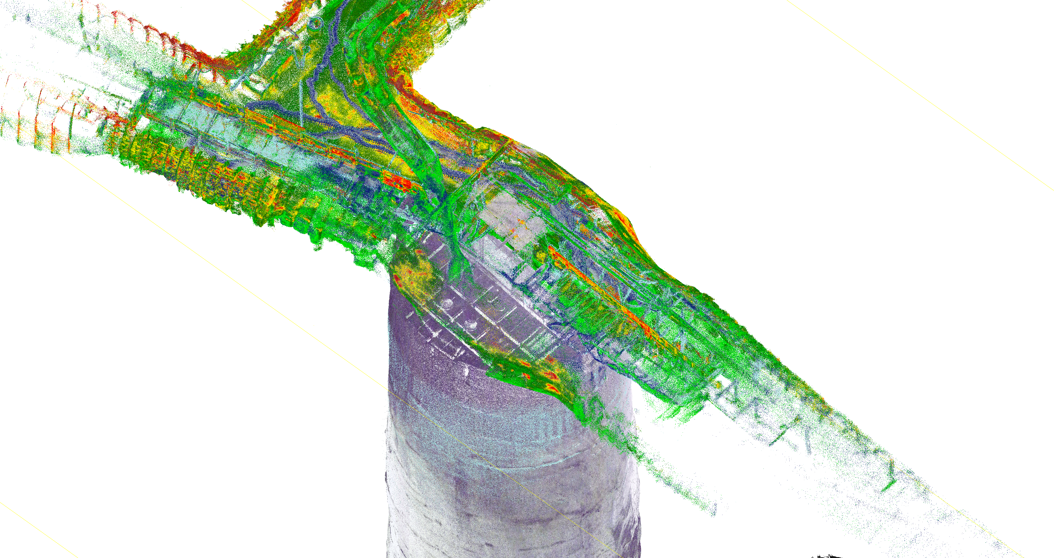
Multi session project - inspect data in CloudCompare

